Slide 1


Database & Database Applications
Database System Concepts and Architecture

Slide 2
Outline
Data Models and Their Categories
History of Data Models
Schemas, Instances, and States
Three-Schema Architecture
Data Independence
DBMS Languages and Interfaces
Database System Utilities and Tools
Centralized and Client-Server Architectures
Classification of DBMSs

Slide 3
Data Model
Data Model:
A collection of concepts that can be used to describe the structure of database. It provides the necessary means to achieve the data abstraction.
Data Model Structure and Constraints:
Constructs are used to define the database structure
Constructs typically include elements (and their data types) as well as groups of elements (e.g. entity, record, table), and relationships among such groups
Constraints specify some restrictions on valid data; these constraints must be enforced at all times
Data Model Operations:
These operations are used for specifying database retrievals and updates by referring to the constructs of the data model.
Operations on the data model may include basic model operations (e.g. generic insert, delete, update) and user-defined operations (e.g. compute_student_gpa, update_inventory).

Slide 4
Categories of Data Models
Conceptual (high-level, semantic) data models:
Provide concepts that are close to the way many users perceive data.
(Also called entity-based or object-based data models.)
Physical (low-level, internal) data models:
Provide concepts that describe details of how data is stored in the computer storage.
This level is meant for computer specialist not end users.
Describe how data is stored as files in the computer by representing info such as record format, record ordering and access path( like indexes).
Implementation (representational) data models:
Provide concepts that fall between the above two. To make it easily to understood by end users. But not too far removed from the way data is organized in user storage.
used by many commercial DBMS implementations (e.g. relational data models used in many commercial systems).

Slide 5
DB Schema Vs. DB State
Database Schema:
The description of a database. Which is specified during DB design and is not expected to change frequently (descriptions of the database structure, data types, and the constraints on the database).
Schema Diagram: An illustrative display of (most aspects of) a database schema.
Schema Construct: A component of the schema or an object within the schema, e.g., STUDENT, COURSE.
Database State (database instance, occurrence or snapshot).
The actual data stored in a database at a particular moment in time. This includes the collection of all the data in the database.
Distinction
The database schema changes very infrequently.
The database state changes every time the database is updated.
Schema is also called intension.
State is also called extension.

Slide 6
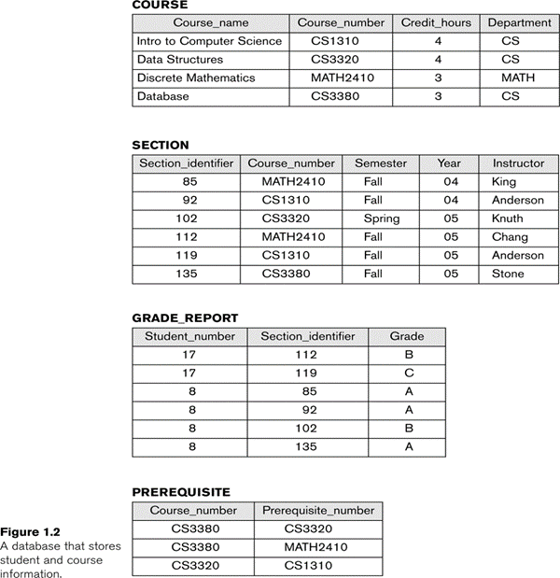
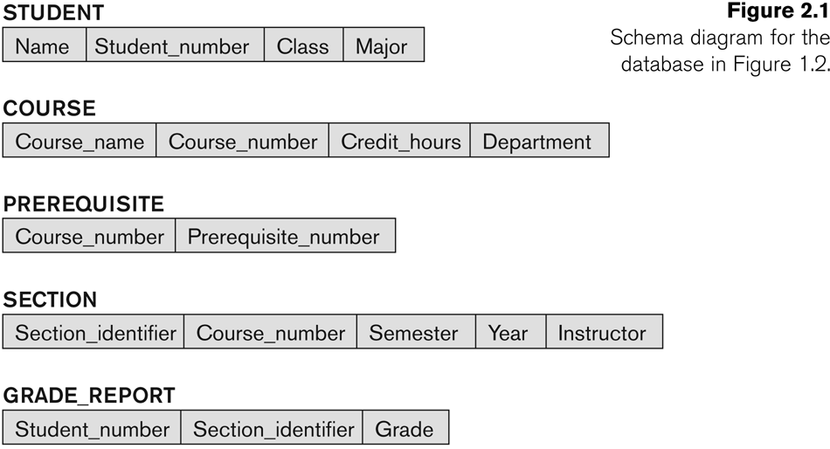
Example of a Database Schema
Database State
Database Schema

Slide 7
Three-Schema Architecture
The goal of three-schema architecture, is to:
Separate the user applications from the physical database.
Program-data independence.
Support of multiple views of the data.
Internal schema at the internal level to describe physical storage structures and access paths (e.g indexes).
Typically uses a physical data model.
Conceptual schema at the conceptual level to describe the structure and constraints for the whole database for a community of users.
Uses a conceptual or an implementation data model.
External schemas at the external level to describe the various user views.

Slide 8
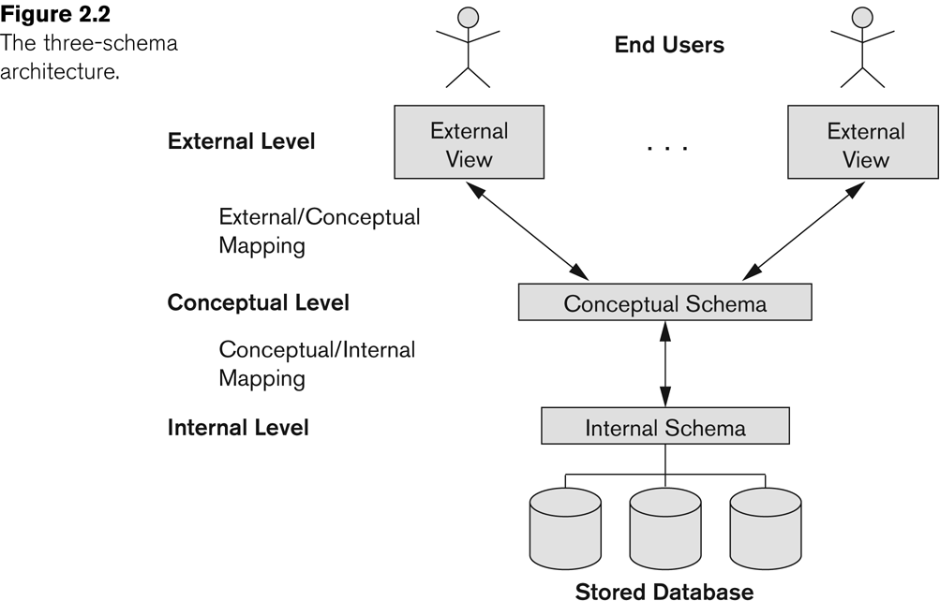
The Three-Schema Architecture

Slide 9
Data Independence
The capacity to change the schema at one level of a database system without having to change the schema at the next higher level.
Two type of data independency
Logical Data Independence:
The capacity to change the conceptual schema without having to change the external schemas and their associated application programs. Such as removing record.
Physical Data Independence:
The capacity to change the internal schema without having to change the conceptual schema.
When a schema at a lower level is changed, only the mappings between this schema and higher-level schemas need to be changed in a DBMS that fully supports data independence.

Slide 10
DBMS Languages
Data Definition Language (DDL)
Used by the DBA and database designers to specify the conceptual schema of a database only
Data Manipulation Language (DML)
Used to specify database retrievals and updates
Data Control Language (DCL)
Used by DBA to Grant and Remove privileges.

Slide 11
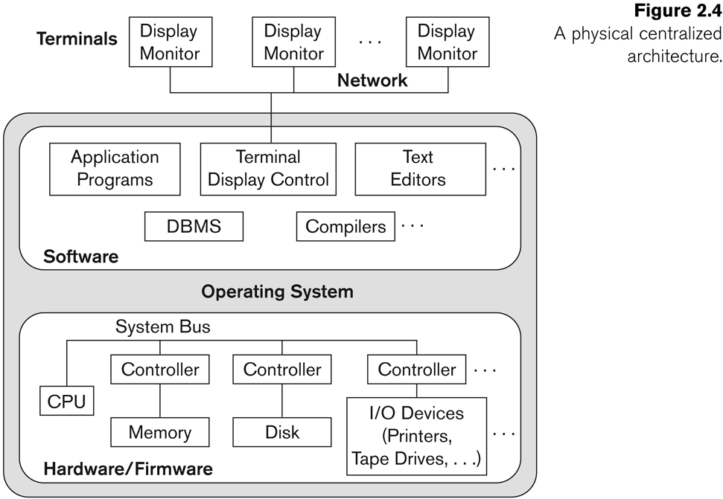
Centralized and Client-Server DBMS Architectures
Centralized DBMS:
Combines everything into single system including- DBMS software, hardware, application programs, and user interface processing software.
User can still connect through a remote terminal – however, all processing is done at centralized site.

Slide 12
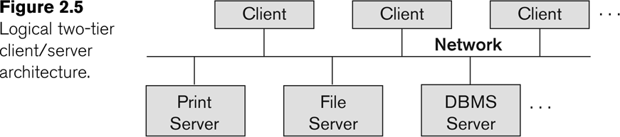
Basic 2-Tier Client-Server Architectures
Specialized Servers with Specialized functions
Print server
File server
DBMS server
Web server
Email server
Clients can access the specialized servers as needed

Slide 13
Basic 2-Tier Client-Server Architectures
Provides database query and transaction services to the clients
Relational DBMS servers are often called SQL servers, query servers, or transaction servers
Applications running on clients utilize an Application Program Interface (API) to access server databases via standard interface such as:
ODBC: Open Database Connectivity standard
JDBC: for Java programming access
Client and server must install appropriate client module and server module software for ODBC or JDBC.
Clients:
Provide appropriate interfaces through a client software module to access and utilize the various server resources.
Clients may be diskless machines or PCs or Workstations with disks with only the client software installed.
Connected to the servers via some form of a network.
(LAN: local area network, wireless network, etc.)

Slide 14
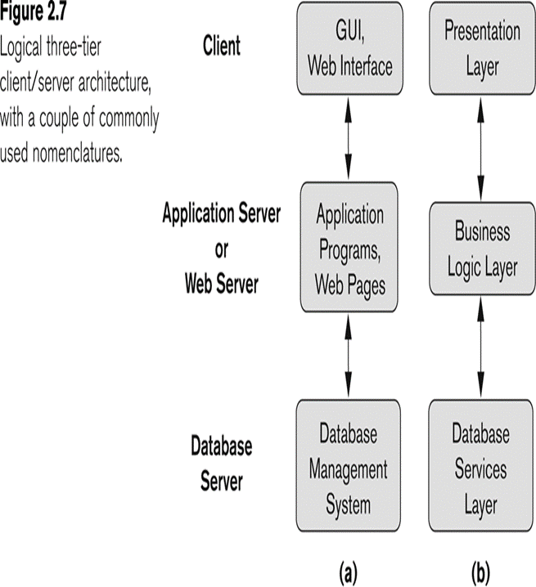
Three Tier Client-Server Architecture
Common for Web applications
Intermediate Layer called Application Server or Web Server:
Stores the web connectivity software and the business logic part of the application used to access the corresponding data from the database server
Acts like a conduit for sending partially processed data between the database server and the client.
Three-tier Architecture Can Enhance Security:
Database server only accessible via middle tier
Clients cannot directly access database server.

Slide 15
Classification of DBMSs
Traditional Vs. Emerging:
Traditional: Relational, Network, Hierarchical.
Emerging: Object-oriented, Object-relational.
Single-user Vs. Multi-User
Single-user (typically used with personal computers) vs. multi-user (most DBMSs).
Centralized Vs. Distributes
Centralized (uses a single computer with one database) vs. distributed (uses multiple computers, multiple databases)

Slide 16
THE END

